Slide 1
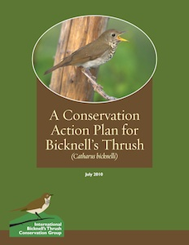
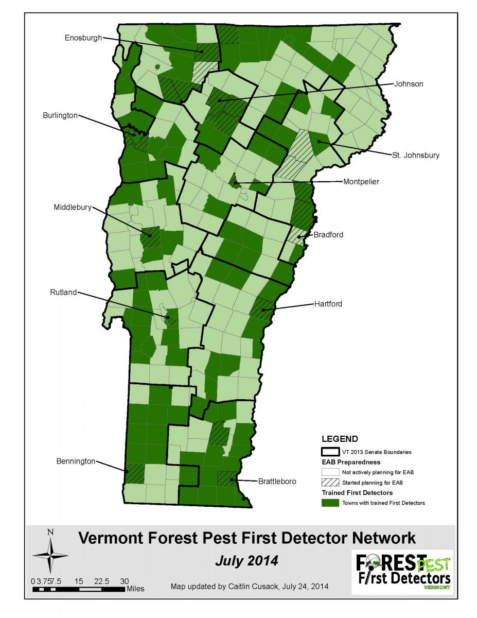
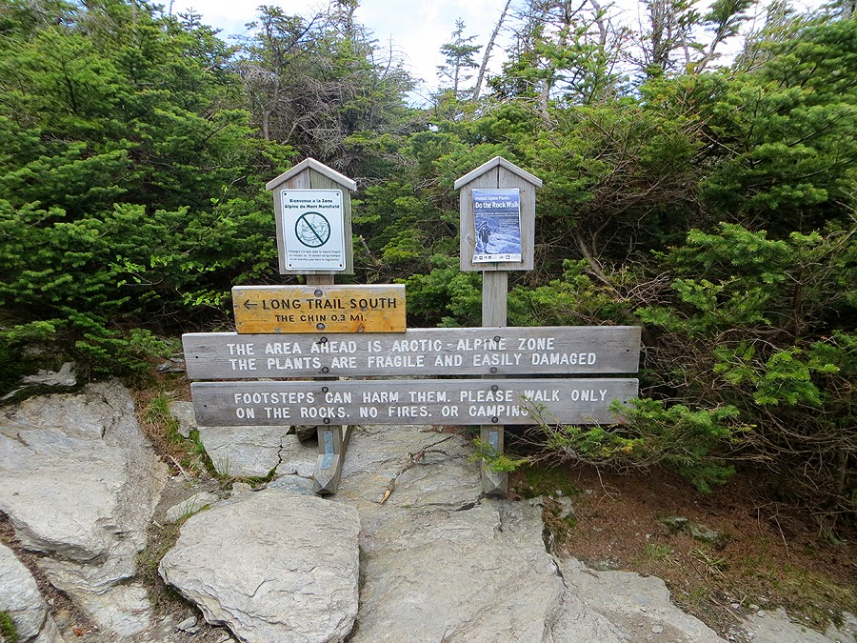

Identifying and Strengthening Tools for Mountain Stewardship
Susan Hindinger, Vermont Center for Ecostudies
Dan Lambert, High Branch Conservation Services
Rick Paradis, UVM Natural Areas Program
Notes:
Images provided as examples only, drawn from keynote
Feel free to swap out for better / other image(s)

Slide 2
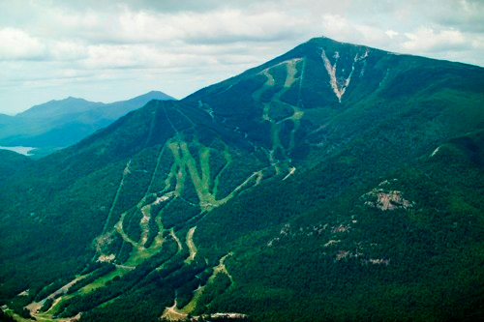
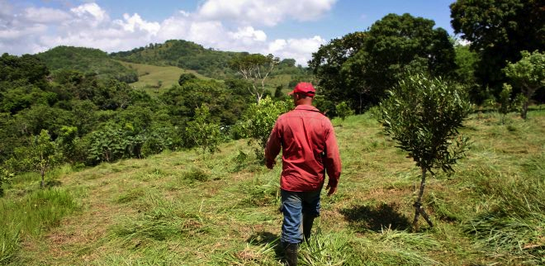
Mountain Field Stations inform conservation and stewardship tools
Reserva Privada Zorzal
Notes:
Morning keynote provided examples of how information gathered at mountain field stations has contributed to the development of conservation and stewardship tools that are in use around the world
These tools are designed promote the health of mountain ecosystems and the vitality of the human communities that inhabit / depend on them
[Dan will produce this slide once keynote presentation is further along]

Slide 3
Stewardship tools take many forms . . .
Policies and laws
Plans
Decision-support tools
Programs
Notes:
Examples from VMC cooperators working on Mount Mansfield and around the state demonstrate how tools can take a variety of forms
Policies (including laws and regulations, such as Act 250, the Clean Air Act, Vermont Wetland and Water Quality Statutes)
Plans (regional plans, forest and park management plans, wildlife conservation strategies)
Decision support (conservation and development planning atlases)
Programs (hiker education – summit caretaker, forest pest monitoring, BITH conservation fund)
Some of the examples that will be presented in the keynote:
Policies: Environmental regulation (Act 250 administered through Vt DEC District Environmental Commissions)
Plans: IBTCG conservation action plan
Decision support: Conservation / development planning atlases
Programs Habitat protection fund (VCE – Adirondack Community Trust)
Hiker education program - GMC
An early warning detection system for invasive forest pests - VTFPR

Slide 4
. . . and influence multiple domains
Air
Soil
Water
Flora
Fauna
People
Notes:
These tools often target individual domains such as:
Air
Soil
Water
Plants
Animals
People
but due to the sensitivity and interconnected nature of mountain ecosystems, tools often confer benefits to several domains at once
For example, Clean Air Act has reduced pollution in air, soil, water, with benefits for plant and animal communities, forest products, and human health
As a stewardship tool, the Clean Air Act is exemplary in another regard: the original 1963 law was updated several times with 1970, 1977, and especially 1990 Amendments drawing on data from air quality and watershed monitoring to increase protections for people and the environment
Lesson = sharpen your tools as new knowledge is acquired
We can, and should, apply adaptive management to our tools as well as to the natural systems we steward, adjusting the tools to incorporate what we learn from science.

Slide 5
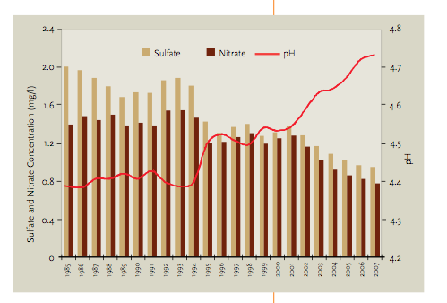
Sleeper et al 2009
Notes:
[expendable slide]
Since 1984, both sulfates and nitrates have decreased by half and pH has risen at Underhill NADP site
Note inflection point following implementation of 1990 amendment
Lesson = sharpen your tools as new knowledge is acquired

Slide 6
Identify Tools & Knowledge Gaps
Domain(s): ___________
Issue | Tool | Tool type | Responsible party(ies)
Questions / Information gaps (and what it would take to address them) How to measure efficacy of the tool?
Notes:
An integrated science and stewardship program – where stewardship activities are guided by science – should include at the outset an inventory of available tools to address important issues and an assessment of information needed to maximize their effectiveness.
This, in turn, can guide the strategic directions of scientific efforts – not suggesting in any way that results are prescribed, but that research is undertaken with, at least in part, a goal of informing stewardship tools and using the science to maximum advantage.
This approach requires the engagement of both parties – scientists and the “tool-handlers” (policy makers, land managers, educators, planners, etc.) – to both understand what information is (or could be) available, what the information needs are, and how it might be applied, in other words what tools are required.
At this gathering, we perhaps have such an intersection, and we also probably have a selection of scientists who are interested in how science is applied for practical stewardship outcomes.
So -- Over the next 30 min, we’d like to capitalize on the rich and varied experience in this room and start this process.
We will first take stock of the tools in our toolkit, working in 3 different breakout groups to fill in this table
Breakout groups will correspond with physical, biological, and social domains: physical (air, soil, water); biological (plants and animals); social (recreation, economy, health)
1. Identify an issue of concern (we’ll provide a list of options)
2. Identify existing policies, plans, programs, decision-support tools etc. that address the issue / designate the type of tool and responsible party (streamline?)
3. Formulate research or monitoring questions that gets at the information needed to strengthen / sharpen each tool
If the information needs are unknown, then the group will identify the agency or individual that should be consulted to get a better handle on the information need
You might consider identifying what it would take to address information gaps – a one year study? Annual monitoring? Online survey? Monthly sampling? are we talking about a $5M, multi-year project with loads of equipment, or a one-time project for a summer intern? And what would the product need to be – either the tool itself, or if the information gap would lead to development of a tool or support its use, how would the science best be delivered to the end user of the tool? Peer reviewed paper? Technical report? Lay audience publication? Map? Spreadsheet? Brochure? Website?
Finally, you might consider how to measure the efficacy of the tool, or the stewardship activities the tool supports? How effectively does the tool address the issue?
What we capture from these discussions will inform the programmatic plan for the MMSSC.
Information gaps associated with tools that cut across multiple domains will be given special consideration when developing research and monitoring projects at the Mount Mansfield Science and Stewardship Center.
For example, a tool that offers benefits / addresses important issues across multiple domains would receive more attention than one that might have more limited impact

Slide 7
Identify Tools & Knowledge Gaps
Domain: Biological
Issue | Tool | Tool type | Responsible party
Trampling | Alpine veg restoration | Program | GMC UVM
Q1: Have restoration efforts resulted in recovery of trampled vegetation since baseline documentation began? Q2: What is the relative contribution of personal outreach, visitor center exhibits, and physical demarcation of fragile areas to alpine plant protection?
Notes:
Give an example of completed cells for a single domain (feel free to choose a different example)
e.g.,
DOMAIN: Biological
Issue Program Responsible Party Missing Information
Trampling Outreach by summit caretaker GMC
Visitor center exhibit GMC
Alpine vegetation restoration GMC, UVM Natural Areas?? Has the restoration effort resulted in recovery of trampled vegetation since baseline documentation?
Both of these questions get at measuring the effectiveness of the approach, or the tool. So research into these questions would inform revision of the approach if the data indicated that no improvement was detected.

Slide 8
Issues to Consider
Acid deposition / leaching of base cations
Hg deposition / methylation
N enrichment
Erosion
Altered stream flow
Elevated stream salinity/water quality issues
Aquifers/groundwater recharge
Climate change
Disruption of cone cycle
Direct impacts of recreation on habitats/wildlife (noise, trampling, openings)
Habitat loss and fragmentation
Recreational opportunity
Economic opportunity
???

Slide 9
Breakout Groups
Biological domain (flora, fauna) (Dan)
Physical domain (air, soil, water) (Susan)
Social domain (recreation, economy) (Rick)
Notes:
We’ll leave 5 min at the end of the session for groups to report back on one or two tools and related questions identified in their discussion
Just the beginning,
We’ll ask volunteers in each group to spend a few more hours on this by email conference call over the winter January as part of program planning for the Mansfield Center
Hoping to hold a two-day conference in 2015 to building on this information, develop and prioritize of specific research questions

